Slide 1
SAVING A CANADIAN ICON
BLACKBERRY
Group 6

Slide 2
Company Background
1984: Research In Motion was founded by Mike Lazaridis and Douglas Fregin in Waterloo, Ontario​.
1988: RIM begins developing products for Mobitex wireless data communications networks, often used by military and police forces, firefighters and ambulance services​.
1996: RIM’s first pager is released and the company goes public after a year.​
2002: RIM adds voice calling capabilities to their device.
2004: Blackberry crossed the one million mark. By the end of the year, more than two million people were using its devices .
2007: RIM becomes the most valuable company with a market capitalization surpassing $67 billion. ​​
2008: Google unveils it’s open source platform Android​

Slide 3
…continued
2010: RIM buys QNX Software Systems for C$200 million
2012: Both the CEOs step down. New CEO announces 5,000 layoffs.
2013: Heins unveils the BlackBerry 10 operating system. In the same year, Heins is replaced by the new CEO John Chen
2015: Blackberry succumbed to the pressure to release its first ever Android phone
​
2016: Blackberry stopped making smartphones and outsourced all hardware development to external partners​
2018: BlackBerry will be working with Jaguar Land Rover to develop software for the car manufacturer's vehicles​

Slide 4
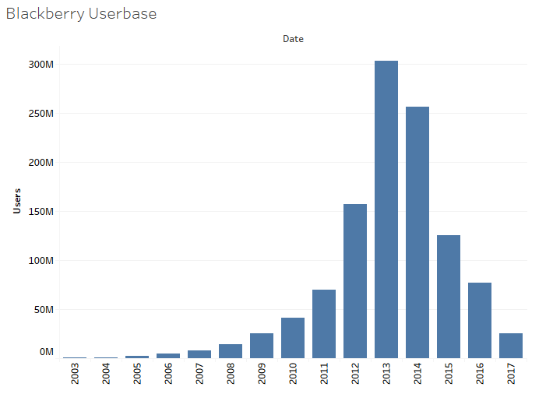
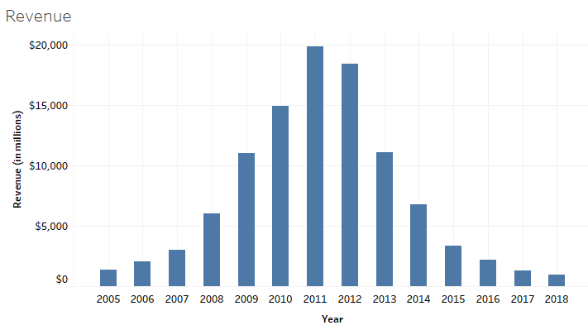
Userbase
Revenue

Slide 5
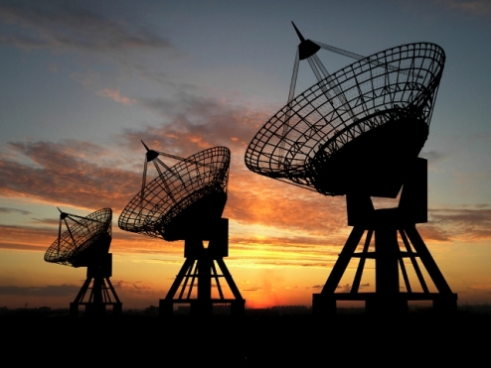

Target Customers
Defence Communication
Systems which require more secured operations
Data Centres

Slide 6
Strategy
What will we do?
For several decades, Blackberry has led the mobile industry in security. Blackberry will now leverage its core strengths to expand into a critical market.
How will we do?
The new service will address secure gaps and vulnerabilities that may exist with current military software as hardware services.
Blackberry is recognized worldwide for the integrity and security of its software, often the providers of choice for many Governments.
Why will we do?

Slide 7
Industrial Analysis
Global rugged equipment market is expected to grow at a CAGR of close to 3% between 2019-2022
Market driver – Global increase in military expenditure
US has the highest military expenditure (Increased military spending by 22% in 2016)

Slide 8
Strategic Sweet Spot
Blackberry OS is more secure than Android which is the OS of choice in the rugged equipment market
iOS devices do not have much of a market presence in this sector, are priced higher and are heavily reliant on Apple security practices
Blackberry is built for MDM, making it easier for a company to manage and protect its devices

Slide 9
Marketing Plan
Work towards building strategic relationships with different military and security organizations
Owing to the fact that Blackberry aims to improve national security, Blackberry could solicit funding and special privileges from the government to help finance its new ventures

Slide 10
Operations Plan
Meet military needs by developing products with the following features:
Compatibility with night vision
Military grade encryption
Quickly erasable data
Touchscreens that support the use of gloves
Extreme environment durability (eg. superhydrophobic nanotech coating for water resistance)

Slide 11
Operations Plan (Continued)
2. Hire a set of skilled developers to develop military/tactical applications that are exclusive to military edition blackberry devices. Requirement gathering for these applications can be taken from different military organization worldwide

Slide 12
Operations Plan (Continued)
Enter IoT realm with a focus on military applications. Applications including:
Logistics
Smart Bases
Data Warfare

Slide 13
Strengths Blackberry is competitive in security and has a formidable leadership team, with a diverse range of skills The security features inherent in the devices are unmatched by any other mobile makers It’s rugged and tough devices are fit-for-purpose in the rough environments making it an ideal phone for the military Focused approach on satisfying the needs of the narrow segment of customers | Weaknesses Finding connections with the military organizations. Understand the technology and security gaps in the organizations. Owing to the downfall of the company, it may be difficult to set up the market again.
Opportunities All the competitors are focused towards the better user experience. This is a chance for blackberry to leverage this opportunity to exploit its competitive security and serve the military with its innovation. Blackberry’s past reputation with the government would help the company rise quickly in the market again. | Threats Blackberry will have to keep up with the rapid technological changes. Military officials renew their contracts with suppliers every few years. Being highly dependent on the military contracts, a loss of contract from one organization will result in substantially lower sales.
SWOT
Analysis

Slide 14
PLAN
Create a sense of urgency
In order to bring the development of the new military forward, leadership needs to create a sense of urgency with the project team.
Build a guiding coalition
A diverse group of employees with varying roles, skills & experience will be the driving force behind the new product development.
Form a change vision and strategic initiatives
With an idea in place and underdevelopment, the team leading the new military product development will gain full support from the executive team.
Enlist a volunteer army
A list of supportive staff who would embrace the project to build a new product and service will be appointed.

Slide 15
…continued
Enable action by removing barriers
With the support of the executive team and key leaders, the project team will have continued support to access appropriate resources and infrastructure.
Generate and celebrate short term wins
The hard work and small advancements should be supported with tangible and non-tangible recognition.
Sustain acceleration
As the launch date nears, the team must fully understand the impact of their final efforts on perfecting the product.
As the team’s skills grow, individuals can be moved to other teams to transfer their skills, embedding a new level of engagement across other Blackberry teams.
Institute change

Slide 16
THANK YOU

